Slide 1
Who’s birthday is it today?
Ryan
Rebecca
Steven
George

Slide 2
Who’s birthday is it today?
Ryan!!!!
Rebecca
Steven
George

Slide 3
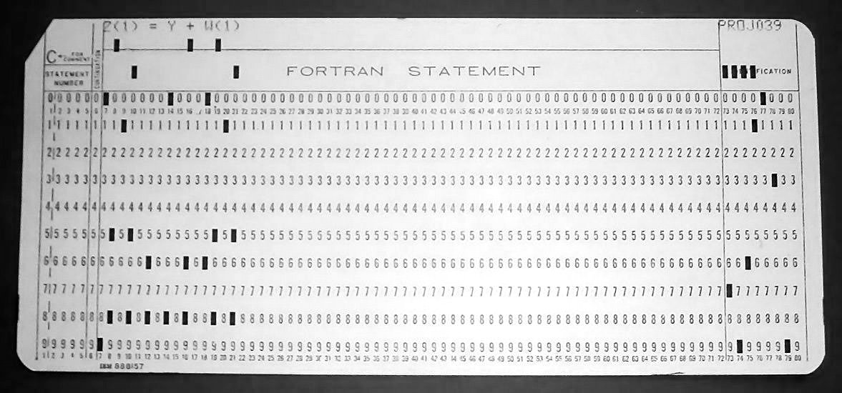

Introduction to Machine Language
Instructor: Rebecca Herman

Slide 4
Review of Last Lecture
C Memory Layout
Local variables disappear because Stack changes
Global variables don’t disappear because they are in Static Data
Dynamic memory available using malloc and free, but must be used VERY CAREFULLY

Slide 5
Using Memory You Don’t Own (2)
What is wrong with this code?
char *append(const char* s1, const char *s2) {
const int MAXSIZE = 128;
char result[MAXSIZE];
int i=0, j=0;
for (; i<MAXSIZE-1 && j<strlen(s1); i++,j++)
result[i] = s1[j];
for (j=0; i<MAXSIZE-1 && j<strlen(s2); i++,j++)
result[i] = s2[j];
result[++i] = '\0';
return result;
}
Local array appears on Stack
Pointer to Stack (array) no longer valid once function returns
Notes:
Beyond Stack Read or Write (BSR, BSW) :
If the address of a local variable in a function is directly or indirectly stored in a global variable, in a heap memory location, or somewhere in the stack frame of an ancestor function in the call chain, upon returning from the function, it becomes a stack dangling pointer. When a stack dangling pointer is de-referenced to read from or write to the memory location, it accesses memory outside of the current stack boundaries, and Purify reports a BSR or BSW error. Uninitialized pointer variables or incorrect pointer arithmetic can also result in BSR or BSW errors.
In the example in Listing 7, the append method returns the address of a local variable. Upon returning from that method, the stack frame for the method is freed, and stack boundry shrinks. Now the returned pointer would be outside the stack bounds. If you use that pointer, Purify will report a BSR or BSW error. In the example, you would expect append("IBM ", append("Rational ", "Purify")) to return "IBM Rational Purify", but it returns garbage manifesting BSR and BSW errors.
Maybe think of a better more clear concise example

Slide 6
Using Memory You Haven’t Allocated
What is wrong with this code?
char buffer[1024]; /* global */
int main(int argc,char *argv[]) {
strcpy(buffer,argv[1]);
...
}
What if more than a kibi characters?
This is called BUFFER OVERRUN or BUFFER OVERFLOW and is a security flaw!!!
Notes:
Using memory that you haven't allocated, or buffer overruns
When you don't do a boundary check correctly on an array, and then you go beyond the array boundary while in a loop, that is called buffer overrun. Buffer overruns are a very common programming error resulting from using more memory than you have allocated. Purify can detect buffer overruns in arrays residing in heap memory, and it reports them as array bound read (ABR) or array bound write (ABW) errors. (See Listing 8.)

Slide 7

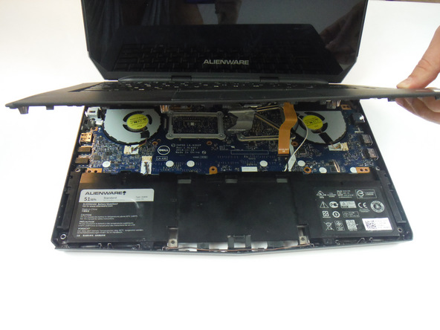



Notes:
When I started studying computer science in CS61A here at Berkeley, I was incredibly troubled by the very concept of writing programs. I was completely mind-blown every time the staff showed us something new you could do on the computer, and I remember sitting in shock and wondering “how does the computer know what I’m telling it to do….” The 61A staff refused to answer my questions -- they said with indignation “you don’t need to know how to build a car in order to drive it!” (Actually, as a physics major and wanna-be engineer, I do have a pretty good idea of how a car works, but nevermind…) The computer was like a box of magic -- a piece of metal that could somehow understand complex concepts like “truth” and recursion -- concepts that philosophers and 61A students have been struggling with for centuries.
But what was perhaps more astonishing than that was that the computer knew how to reach these concepts from my words. I had actually just taken an entire philosophy class called “The Theory of Meaning” where we basically concluded that it wasn’t possible for humans to consistently communicate ideas through words, so how could the computer possibly interpret those words?!
As it turns out, since humans designed computers, it’s a lot easier to understand the way computers interpret words than the way we do.
For the moment, we’ll leave understanding the brain to cognitive and neuroscientists, linguists and philosophers. But we will take a closer look at the computer to learn how it understands us.

Slide 8
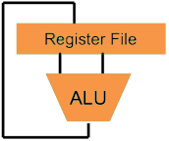
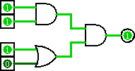
Great Idea #1: Levels of Representation/Interpretation
We are here_
Higher-Level Language Program (e.g. C)
temp = v[k];
v[k] = v[k+1];
v[k+1] = temp;
Compiler
lw $t0, 0($2)
lw $t1, 4($2)
sw $t1, 0($2)
sw $t0, 4($2)
We are here_
Assembly Language Program (e.g. MIPS)
EVERY COMMAND IS DIRECTLY IMPLEMENTED IN THE HARDWARE
Assembler
0000 1001 1100 0110 1010 1111 0101 1000
1010 1111 0101 1000 0000 1001 1100 0110
1100 0110 1010 1111 0101 1000 0000 1001
0101 1000 0000 1001 1100 0110 1010 1111
Machine Language Program (MIPS)
Machine Interpretation
Hardware Architecture Description (e.g. block diagrams)
Architecture Implementation
Logic Circuit Description (Circuit Schematic Diagrams)
Notes:
And in order to do that, we will move on from C to Assembly language, in which every command is directly implemented in the hardware of the computer. WHAT DID I JUST SAY?! (We’ll learn how we translate between higher level languages like C and assembly language -- this compiler step -- in a few days. And later in the course we will learn how the hardware directly supports assembly language instructions.)
Again, this is not a class about computer languages or programming. However in order to learn the important concepts of machine language, we must pick a language to study as an example, and that is what we will study for the next 3 days.

Slide 9



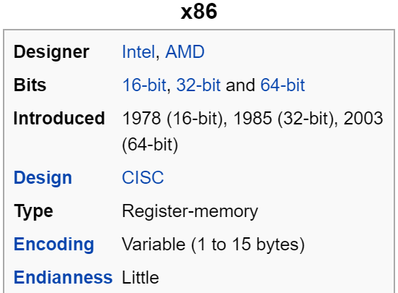
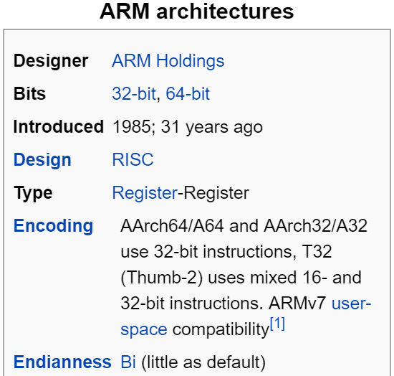
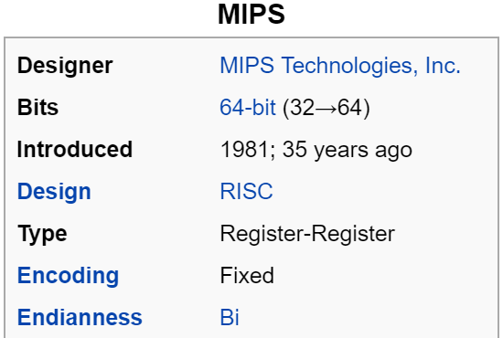
Mainstream ISAs
Macbooks & PCs
(Core i3, i5, i7, M)
x86 Instruction Set
Smartphone-like devices
(iPhone, iPad, Raspberry Pi)
ARM Instruction Set
Digital home & networking equipment
(Blu-ray, PlayStation 2)
MIPS Instruction Set
Notes:
We have many choices as to which assembly language we could pick:
intel x86, which is the machine language used by most of our laptops.
Why don’t we?
SUPER long and complicated
Arm, which is used in our iphone
MIPS: used in home devices -- less and less prevalent.
ARM stands for Advanced RISC Machine
MIPS was originally an acronym for Microprocessor without Interlocked Pipeline Stages. Developed by MIPS Technologies (formerly MIPS Computer Systems, Inc.).

Slide 10
Complex/Reduced Instruction Set Computing
Early trend: add more and more instructions to do elaborate operations – Complex Instruction Set Computing (CISC)
difficult to learn and comprehend language
super-complicated (slow?) hardware
Opposite philosophy later began to dominate: Reduced Instruction Set Computing (RISC)
Simpler (and smaller) instruction set makes it easier to build fast hardware
Let software do the complicated operations by composing simpler ones
Notes:
x86 fell victim to the “early trend” -- every time we want to do something complicated, let’s just implement it directly in the hardware! Downsides…
no one person can know the whole things
WHAT’S THE RULE ABOUT ASSEMBLY LANGUAGE?

Slide 11
Mainstream ISAs
Macbooks & PCs
(Core i3, i5, i7, M)
x86 Instruction Set
Smartphone-like devices
(iPhone, iPad, Raspberry Pi)
ARM Instruction Set
Digital home & networking equipment
(Blu-ray, PlayStation 2)
MIPS Instruction Set
Notes:
MIPS and ARM both RISC. We’ll pick MIPS because it came out in Patterson and Hennesey first and because it’s free. However, next semester switching to a language named after the concept of Reduced Instruction Set Computing: RISC-V!
ARM stands for Advanced RISC Machine
MIPS was originally an acronym for Microprocessor without Interlocked Pipeline Stages. Developed by MIPS Technologies (formerly MIPS Computer Systems, Inc.).

Slide 12
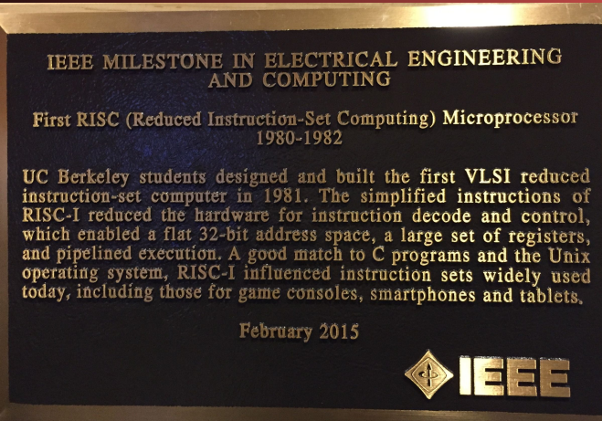
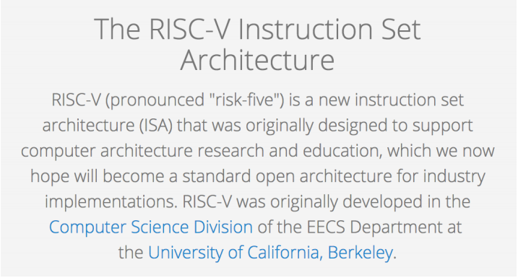
Next Semester -- RISC-V!

Slide 13
RISC Extreme -- One Instruction Set Computing
Subtract and branch if not equal to zero
The SBNZ a, b, c, d instruction ("Subtract and Branch if Not equal to Zero") subtracts the contents at address a from the contents at address b, stores the result at address c, and then, if the result is not 0, transfers control to address d (if the result is equal zero, execution proceeds to the next instruction in sequence).
c = b - a; jump to instruction d if a=b
Notes:
In it’s extreme -- we get “One Instruction Set Computing”
a, b the parameters of your condition
best things come from a BALANCE.

Slide 14
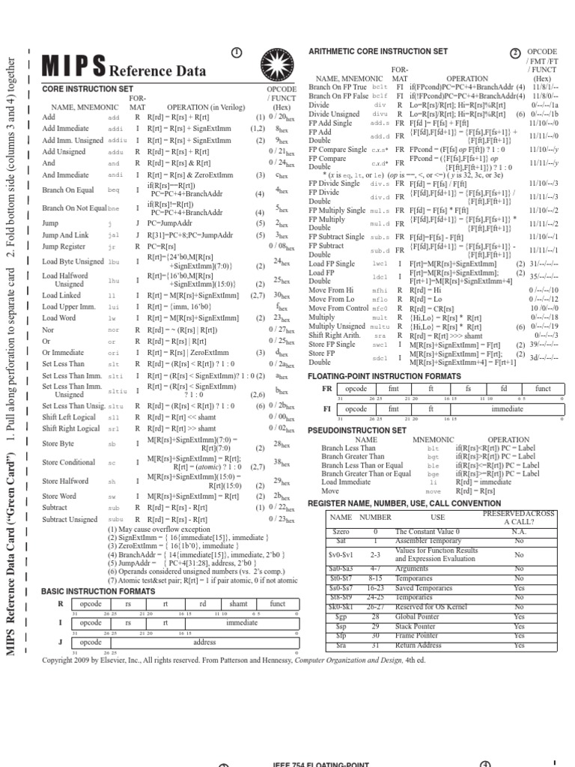
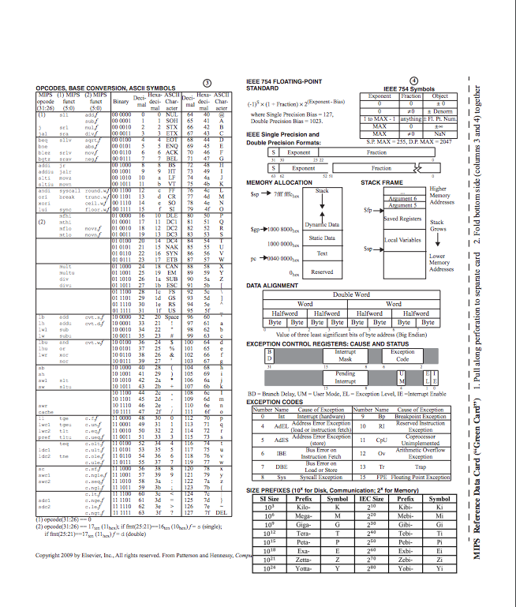
MIPS Manual
https://www.cs.cornell.edu/courses/cs3410/2008fa/MIPS_Vol2.pdf (Instruction Set)
http://www.cs.cornell.edu/courses/cs3410/2008fa/MIPS_Vol1.pdf (Architecture)
Notes:
Don’t fear -- while there are manuals for MIPS that are hundreds of pages long, most of what you need to know can be summarized on one double-sided green piece of paper (inside your P&H)

Slide 15
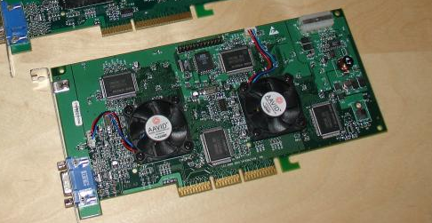
Variables in Hardware
Already know instructions must be directly implemented in hardware
What about variables?!?!
Live in Memory
Relative to your processor, memory is soooooo sloooooowwwwwwwwwwwwwwww
predetermined small number of fast registers in processor to hold variables.
Notes:
memory is slow, partially because it’s big so it takes a while to interact with, and partially because it’s big, so we build it a little more cheaply. Want to fix that by building better, more expensive hardware to house variables. But how many will you need?!?!
Hardware -- it’s physical, so it’s there or it’s not. You are a programmer, not God -- you can’t just say “let there be another variable!” or “let there be another register!” and have it appear. Must pick some number.

Slide 16
Registers vs. Memory
What if more variables than registers?
Keep most frequently used in registers and move the rest to memory (called spilling to memory)
Why not all variables in memory?
Smaller is faster: registers 100-500 times faster
Registers more versatile
In 1 arithmetic instruction: read 2 operands, perform 1 operation, and 1 write
In 1 data transfer instruction: 1 read/write, no operation

Slide 17
MIPS -- How Many Registers?
Tradeoff between speed and availability
more registers → can house more variables simultaneously; all registers are slower.
MIPS has 32 registers ($0-$31)
Each register is 32 bits wide and holds a word
Notes:
word = group of 32 bits (like how byte = group of 8 bits)
For the sake of comparison, ARM uses 16 registers.
How many bytes is a word?
what if we need more variables than that?!

Slide 18
MIPS Registers
Register denoted by ‘$’ can be referenced by number ($0-$31) or name:
Registers that hold programmer variables:
$s0-$s7 ⬌ $16-$23
Registers that hold temporary variables:
$t0-$t7 ⬌ $8-$15
$t8-$t9 ⬌ $24-$25
You’ll learn about the other 14 registers later
Registers have no type (C concept); the operation being performed determines how register contents are treated
Notes:
Both the book and the a quick Google search do not provide a sufficient explanation for why $t8 and $t9 are separated from the other temporary registers.

Slide 19
Registers -- Summary
In high-level languages, number of variables limited only by available memory
ISAs have a fixed, small number of operands called registers
Special locations built directly into hardware
Benefit: Registers are EXTREMELY FAST (faster than 1 billionth of a second)
Drawback: Operations can only be performed on these predetermined number of registers
Notes:
Registers visible to compiler (or MIPS programmer).

Slide 20
Registers in a Computer
We begin our study of how a computer works!
Control
Datapath
Memory
Input
Output
Registers are part of the Datapath
Computer
Processor
Memory
Devices
Control
(“brain”)
Input
Datapath
Registers
Output
Notes:
That is, any computer, no matter how primitive or advance, can be divided into five parts:
1) The input devices bring the data from the outside world into the computer.
2) These data are kept in the computer’s memory until...
3) The datapath request and process them.
4) The operation of the datapath is controlled by the computer’s controller.
All the work done by the computer will NOT do us any good unless we can get the data back to the outside world, so…
5) Getting the data back to the outside world is the job of the output devices.
The most COMMON way to connect these 5 components together is to use a network of busses.

Slide 21
Administrivia
HW0 (Number Rep) due TONIGHT at midnight
minibios due in discussion today!
HW1 (C) due Wednesday (6/28)
Proj1 (Flights) due Thursday (6/29)
Project Party TONIGHT (540AB Cory Hall; 5PM - 7PM)
No lecture or labs on July 4th
HW2 (MIPS) released tonight, due Monday, 7/3

Slide 22
MIPS Agenda
Basic Arithmetic Instructions
Comments
$zero
Immediates
Overflow
Data Transfer Instructions
Decision Making Instructions
Bonus: C to MIPS Practice
Bonus: Additional Instructions

Slide 23
MIPS Instructions (1/2)
Instruction Syntax is rigid:
op dst, src1, src2
1 operator, 3 operands
op = operation name (“operator”)
dst = register getting result (“destination”)
src1 = first register for operation (“source 1”)
src2 = second register for operation (“source 2”)
Keep hardware simple via regularity

Slide 24
MIPS Instructions (2/2)
One operation per instruction, at most one instruction per line
Assembly instructions are related to C operations (=, +, -, *, /, &, |, etc.)
Must be, since C code decomposes into assembly!
A single line of C may break up into several lines of MIPS

Slide 25
MIPS Instructions Example
Your very first instructions! (assume here that the variables a, b, and c are assigned to registers $s1, $s2, and $s3, respectively)
Integer Addition (add)
C: a = b + c
MIPS: add $s1, $s2, $s3
Integer Subtraction (sub)
C: a = b - c
MIPS: sub $s1, $s2, $s3

Slide 26
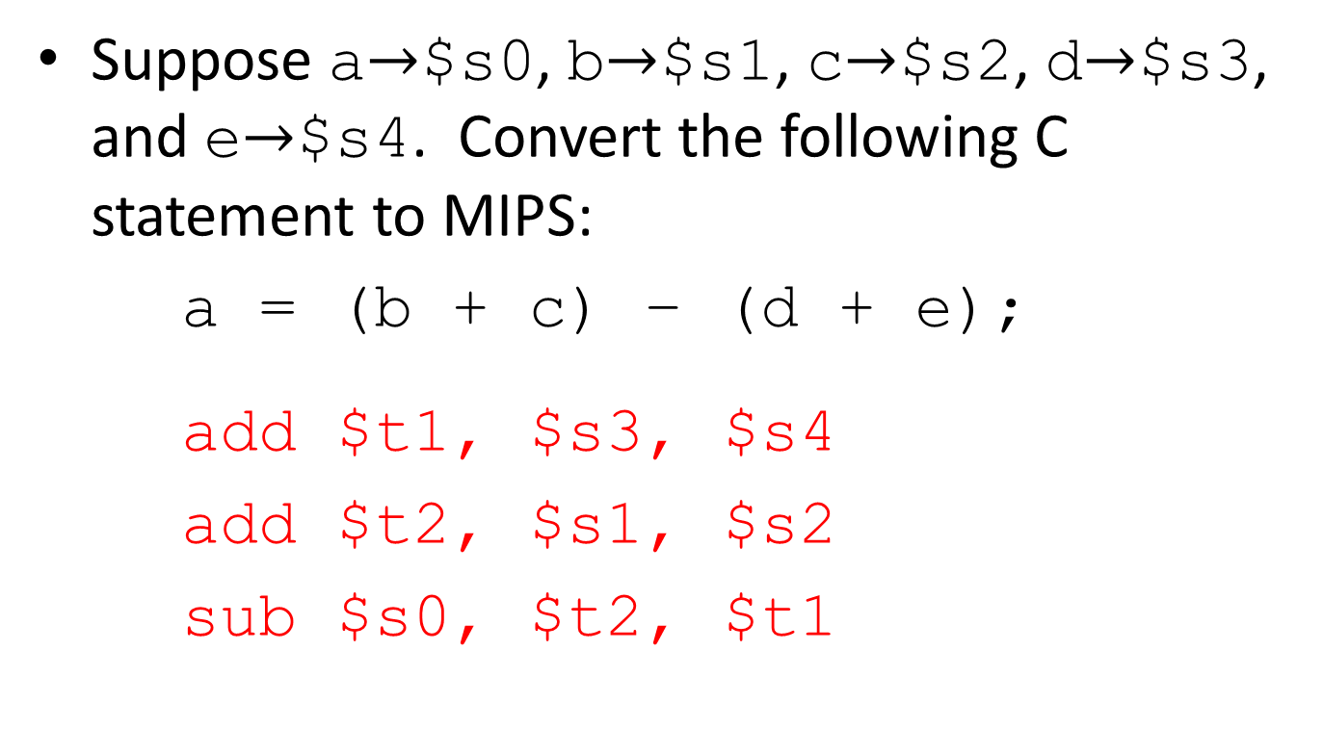
MIPS Instructions Example
Ordering of instructions matters (must follow order of operations)
Utilize temporary registers
Notes:
add $so, $s1, $s2
add $t0, $s3, $s4
sub $s0, $s0, $t0

Slide 27
MIPS Agenda
Basic Arithmetic Instructions
Comments
$zero
Immediates
Overflow
Data Transfer Instructions
Decision Making Instructions
Bonus: C to MIPS Practice
Bonus: Additional Instructions

Slide 28
Comments in MIPS
Comments in MIPS follow hash mark (#) until the end of line
Improves readability and helps you keep track of variables/registers!
add $t1, $s3, $s4 # $t1=d+e
add $t2, $s1, $s2 # $t2=b+c
sub $s0, $t2, $t1 # a=(b+c)-(d+e)

Slide 29
MIPS Agenda
Basic Arithmetic Instructions
Comments
$zero
Immediates
Overflow
Data Transfer Instructions
Decision Making Instructions
Bonus: C to MIPS Practice
Bonus: Additional Instructions

Slide 30
The Zero Register
Zero appears so often in code and is so useful that it has its own register!
Register zero ($0 or $zero) always has the value 0 and cannot be changed!
i.e. any instruction with $0 as dst has no effect
Example Uses:
add $s3, $0, $0 # c=0
add $s1, $s2, $0 # a=b

Slide 31
MIPS Agenda
Basic Arithmetic Instructions
Comments
$zero
Immediates
Overflow
Data Transfer Instructions
Decision Making Instructions
Bonus: C to MIPS Practice
Bonus: Additional Instructions

Slide 32
Immediates
Numerical constants are called immediates
Separate instruction syntax for immediates:
opi dst, src, imm
Operation names end with ‘i’, replace 2nd source register with an immediate (check Green Sheet for un/signed)
Example Uses:
addi $s1, $s2, 5 # a=b+5
addi $s3, $s3, 1 # c++
Why no subi instruction?
Notes:
Goal of RISC is to minimize instruction set. subi dst, src, imm = addi dst, src, -imm.

Slide 33
MIPS Agenda
Basic Arithmetic Instructions
Comments
$zero
Immediates
Overflow
Data Transfer Instructions
Decision Making Instructions
Bonus: C to MIPS Practice
Bonus: Additional Instructions

Slide 34
Arithmetic Overflow
Recall: Overflow occurs when there is a mistake in arithmetic due to the limited precision in computers
i.e. not enough bits to represent answer
MIPS detects overflow (throws error)
“If the addition results in 32-bit 2’s complement arithmetic overflow, the destination register is not modified and an Integer Overflow exception occurs”
Arithmetic “unsigned” instructions ignore overflow
Overflow Detection | No Overflow Detection
add dst,src1,src2 | addu dst,src1,src2
addi dst,src1,src2 | addiu dst,src1,src2
sub dst,src1,src2 | subu dst,src1,src2
Notes:
If you are using the registers as unsigned integers, should you use add?

Slide 35
So Many More Instructions

Slide 36
MIPS Agenda
Basic Arithmetic Instructions
Comments
$zero
Immediates / Overflow
Data Transfer Instructions
Decision Making Instructions
Bonus: C to MIPS Practice
Bonus: Additional Instructions

Slide 37
Five Components of a Computer
Data Transfer instructions are between registers (Datapath) and Memory
Allow us to fetch and store operands in memory
Computer
Processor
Memory
Devices
Control
(“brain”)
Input
Datapath
Registers
Store (to)
Output
Load (from)
Notes:
That is, any computer, no matter how primitive or advance, can be divided into five parts:
1) The input devices bring the data from the outside world into the computer.
2) These data are kept in the computer’s memory until...
3) The datapath request and process them.
4) The operation of the datapath is controlled by the computer’s controller.
All the work done by the computer will NOT do us any good unless we can get the data back to the outside world, so…
5) Getting the data back to the outside world is the job of the output devices.
The most COMMON way to connect these 5 components together is to use a network of busses.

Slide 38
Data Transfer
C variables map onto registers; What about large data structures like arrays?
Don’t forget memory, our one-dimensional array indexed by addresses starting at 0
MIPS instructions only operate on registers!
Specialized data transfer instructions move data between registers and memory
Store: register TO memory
Load: register FROM memory

Slide 39
Data Transfer
Instruction syntax for data transfer:
memop reg, off(bAddr)
memop = operation name (“operator”)
reg = register for operation source or destination
bAddr = register with pointer to memory (“base address”)
off = address offset (immediate) in bytes (“offset”)
Accesses memory at address bAddr+off
Reminder: A register holds a word of raw data (no type) – make sure to use a register (and offset) that point to a valid memory address

Slide 40
Memory is Byte-Addressed
What was the smallest data type we saw in C?
A char, which was a byte (8 bits)
Everything in multiples of 8 bits (e.g. 1 word = 4 bytes)
Memory addresses are indexed by bytes, not words
Word addresses are 4 bytes apart
Word addr is same as left-most byte
Addrs must be multiples of 4 to be “word-aligned”
Pointer arithmetic not done for you in assembly
Must take data size into account yourself
Assume here addr of lowest byte in word is addr of word
…
…
…
…
…
12
13
14
15
word 3
8
9
10
11
word 2
4
5
6
7
word 1
0
1
2
3
word 0

Slide 41
Data Transfer Instructions
Load Word (lw)
Takes data at address bAddr+off FROM memory and places it into reg
Store Word (sw)
Takes data in reg and stores it TO memory at address bAddr+off
Example Usage:
# addr of int A[] -> $s3, a -> $s2
lw $t0,12($s3) # $t0=A[3]
add $t0,$s2,$t0 # $t0=A[3]+a
sw $t0,40($s3) # A[10]=A[3]+a

Slide 42
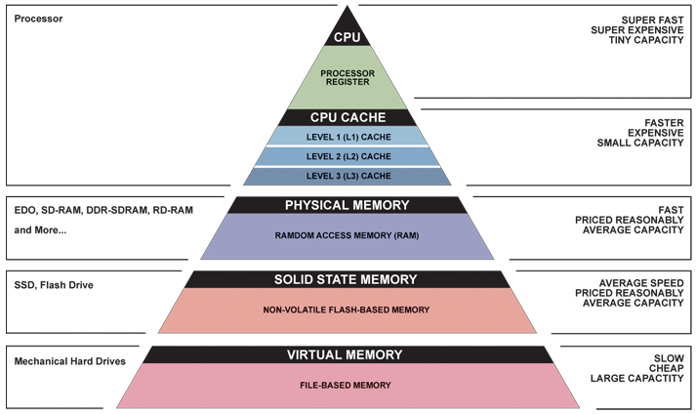
Great Idea #3: Principle of Locality/ Memory Hierarchy
Registers
Memory

Slide 43
Question: Which of the following is TRUE?
(A)
add $t0,$t1,4($t2) is valid MIPS
(B)
If MIPS halved the number of registers available, code would not be twice as fast
(C)
off must be a multiple of 4 for
lw $t0,off($s0) to be valid
(D)
Addu differs from add in that it throws an error upon unsigned overflow instead of 2’s complement overflow

Slide 44

Meet The $taff
 | Rebecca | Steven
Favorite artist? | $imon & Garfunkel / Tory Amos / Brahms | Bleachers
Bribe food? | All sweet things | Pomegranates
Favorite game? | Hearts & Canasta, Evolution | Maplestory
Coolest place you've been to? | New Zealand, Australia | Lake Tahoe

Slide 45
MIPS Agenda
Basic Arithmetic Instructions
Comments
$zero
Immediates / Overflow
Data Transfer Instructions
Decision Making Instructions
Bonus: C to MIPS Practice
Bonus: Additional Instructions

Slide 46
Computer Decision Making
In C, we had control flow
Outcomes of comparative/logical statements determined which blocks of code to execute
In MIPS, we can’t define blocks of code; all we have are labels
Defined by text followed by a colon (e.g. main:) and refers to the instruction that follows
Generate control flow by jumping to labels
C has these too, but they are considered bad style

Slide 47
Decision Making Instructions
Branch If Equal (beq)
beq reg1,reg2,label
If value in reg1 = value in reg2, go to label
Branch If Not Equal (bne)
bne reg1,reg2,label
If value in reg1 ≠ value in reg2, go to label
Jump (j)
j label
Unconditional jump to label

Slide 48
Breaking Down the If Else
C Code:
MIPS (beq):
if(i==j) {
a = b /* then */
} else {
a = -b /* else */
}
In English:
If TRUE, execute the THEN block
If FALSE, execute the ELSE block
# i→$s0, j→$s1
# a→$s2, b→$s3
beq $s0,$s1,then
else:
sub $s2, $0, $s3
j end
then:
add $s2, $s3, $0
end:
???
???
This label unnecessary

Slide 49
Breaking Down the If Else
C Code:
MIPS (bne):
if(i==j) {
a = b /* then */
} else {
a = -b /* else */
}
In English:
If TRUE, execute the THEN block
If FALSE, execute the ELSE block
# i→$s0, j→$s1
# a→$s2, b→$s3
bne $s0,$s1,else
then:
add $s2, $s3, $0
j end
else:
sub $s2, $0, $s3
end:
???
???

Slide 50
Branching on Conditions other than (Not) Equal
Set Less Than (slt)
slt dst, reg1,reg2
If value in reg1 < value in reg2, dst = 1, else 0
Set Less Than Immediate (slti)
slti dst, reg1,imm
If value in reg1 < imm, dst = 1, else 0

Slide 51
Breaking Down the If Else
C Code:
MIPS (???):
if(i<j) {
a = b /* then */
} else {
a = -b /* else */
}
In English:
If TRUE, execute the THEN block
If FALSE, execute the ELSE block
# i→$s0, j→$s1
# a→$s2, b→$s3
slt $t0 $s0 $s1
beq $t0,$0,else
then:
add $s2, $s3, $0
j end
else:
sub $s2, $0, $s3
end:
???
???

Slide 52
Loops in MIPS
There are three types of loops in C:
while, do…while, and for
Each can be rewritten as either of the other two, so the same concepts of decision-making apply
You will examine how to write these in MIPS in discussion
Key Concept: Though there are multiple ways to write a loop in MIPS, the key to decision-making is the conditional branch
Notes:
When you reach the end of a loop, use a conditional branch instruction to decide whether to jump to the start of the loop or not.

Slide 53
Question: Which of the following is FALSE?
(and if TRUE, try writing it out)
(A)
We can make an unconditional branch from a conditional branch instruction
(B)
We can make a for loop with just j (no beq or bne)
(C)
We can make a for loop without using j
(D)
Not every control flow segment written with beq can be written in the same number of lines with bne

Slide 54
Summary
Computers understand the instructions of their ISA
RISC Design Principles
Smaller is faster, keep it simple
MIPS Registers: $s0-$s7, $t0-$t9, $0
MIPS Instructions
Arithmetic: add, sub, addi, addu, subu, addiu
Data Transfer: lw, sw
Branching: beq, bne, j, slt, slti
Memory is byte-addressed

Slide 55
BONUS SLIDES
You are responsible for the material contained on the following slides, though we may not have enough time to get to them in lecture.
You may learn the material just by doing other coursework, but hopefully these slides will help clarify the material.

Slide 56
Agenda
Machine Languages
Registers
Administrivia
Instructions and Immediates
Data Transfer Instructions
Decision Making Instructions
Bonus: C to MIPS Practice
Bonus: Additional Instructions

Slide 57
C to MIPS Practice
Let’s put our all of our new MIPS knowledge to use in an example: “Fast String Copy”
C code is as follows:
/* Copy string from p to q */
char *p, *q;
while((*q++ = *p++) != ‘\0’) ;
What do we know about its structure?
Single while loop
Exit condition is an equality test

Slide 58
C to MIPS Practice
Start with code skeleton:
# copy String p to q
# p→$s0, q→$s1 (pointers)
Loop: lb $t0,0($s0) # $t0 = *p
sb $t0,0($s1) # *q = $t0
addi $s0,$s0,1 # p = p + 1
addi $s1,$s1,1 # q = q + 1
beq $t0,$0,Exit # if *p==0, go to Exit
j Loop # go to Loop
Exit: # N chars in p => N*6 instructions
# $t0 = *p
# *q = $t0
# p = p + 1
# q = q + 1
# if *p==0, go to Exit
# go to Loop

Slide 59
C to MIPS Practice
Fill in lines:
# copy String p to q
# p→$s0, q→$s1 (pointers)
Loop: lb $t0,0($s0) # $t0 = *p
sb $t0,0($s1) # *q = $t0
addi $s0,$s0,1 # p = p + 1
addi $s1,$s1,1 # q = q + 1
beq $t0,$0,Exit # if *p==0, go to Exit
j Loop # go to Loop
Exit: # N chars in p => N*6 instructions
lb $t0,0($s0)
sb $t0,0($s1)
addi $s0,$s0,1
addi $s1,$s1,1
beq $t0,$0,Exit

Slide 60
C to MIPS Practice
Finished code:
# copy String p to q
# p→$s0, q→$s1 (pointers)
Loop: lb $t0,0($s0) # $t0 = *p
sb $t0,0($s1) # *q = $t0
addi $s0,$s0,1 # p = p + 1
addi $s1,$s1,1 # q = q + 1
beq $t0,$0,Exit # if *p==0, go to Exit
j Loop # go to Loop
Exit: # N chars in p => N*6 instructions
Notes:
Is this the only way to write out this function? Of course not.

Slide 61
C to MIPS Practice
Alternate code using bne:
# copy String p to q
# p→$s0, q→$s1 (pointers)
Loop: lb $t0,0($s0) # $t0 = *p
sb $t0,0($s1) # *q = $t0
addi $s0,$s0,1 # p = p + 1
addi $s1,$s1,1 # q = q + 1
bne $t0,$0,Loop # if *p!=0, go to Loop
# N chars in p => N*5 instructions
Notes:
Used fewer instructions!
Instead of “exit when equal to zero”, we are now using “loop when not equal to zero.”

Slide 62
Agenda
Machine Languages
Registers
Administrivia
Instructions and Immediates
Data Transfer Instructions
Decision Making Instructions
Bonus: C to MIPS Practice
Bonus: Additional Instructions

Slide 63
MIPS Arithmetic Instructions
The following commands place results in the special registers HI and LO
Access these values with “move from HI” (mfhi dst) and “move from LO” (mflo dst)
Multiplication (mult)
mult src1,src2
src1*src2: lower 32-bits in LO, upper 32-bits in HI
Division (div)
div src1,src2
src1/src2: puts quotient in LO, remainder in HI

Slide 64
MIPS Arithmetic Instructions
Example:
# mod using div: $s2 = $s0 mod $s1
mod:
div $s0,$s1 # LO = $s0/$s1
mfhi $s2 # HI = $s0 mod $s1

Slide 65
Arithmetic Overflow
Recall: Overflow occurs when there is a mistake in arithmetic due to the limited precision in computers
i.e. not enough bits to represent answer
MIPS detects overflow (throws error)
Arithmetic “unsigned” instructions ignore overflow
Overflow Detection | No Overflow Detection
add dst,src1,src2 | addu dst,src1,src2
addi dst,src1,src2 | addiu dst,src1,src2
sub dst,src1,src2 | subu dst,src1,src2

Slide 66
Arithmetic Overflow
Example:
# $s0=0x80000000, $s1=0x1
add $t0,$s0,$s0 # overflow (error)
addu $t1,$s0,$s0 # $t1=0
addi $t2,$s0,-1 # overflow (error)
addiu $t2,$s0,-1 # $t3=0x7FFFFFFF
sub $t4,$s0,$s1 # overflow (error)
subu $t5,$s0,$s1 # $t5=0x7FFFFFFF
Recall: this is the most negative number

Slide 67
MIPS Bitwise Instructions
Note: a→$s1, b→$s2, c→$s3
Instruction | C | MIPS
And | a = b & c; | and $s1,$s2,$s3
And Immediate | a = b & 0x1; | andi $s1,$s2,0x1
Or | a = b | c; | or $s1,$s2,$s3
Or Immediate | a = b | 0x5; | ori $s1,$s2,0x5
Not Or | a = ~(b | c); | nor $s1,$s2,$s3
Exclusive Or | a = b ^ c; | xor $s1,$s2,$s3
Exclusive Or Immediate | a = b ^ 0xF; | xori $s1,$s2,0xF

Slide 68
Shifting Instructions
In binary, shifting an unsigned number left is the same as multiplying by the corresponding power of 2
Shifting operations are faster
Does not work with shifting right/division
Logical shift: Add zeros as you shift
Arithmetic shift: Sign-extend as you shift
Only applies when you shift right (preserves sign)
Can shift by immediate or value in a register

Slide 69
Shifting Instructions
Instruction Name | MIPS
Shift Left Logical | sll $s1,$s2,1
Shift Left Logical Variable | sllv $s1,$s2,$s3
Shift Right Logical | srl $s1,$s2,2
Shift Right Logical Variable | srlv $s1,$s2,$s3
Shift Right Arithmetic | sra $s1,$s2,3
Shift Right Arithmetic Variable | srav $s1,$s2,$s3
When using immediate, only values 0-31 are accepted
When using variable, only lowest 5 bits are used (read as unsigned)

Slide 70
Shifting Instructions
# sample calls to shift instructions
addi $t0,$0 ,-256 # $t0=0xFFFFFF00
sll $s0,$t0,3 # $s0=0xFFFFF800
srl $s1,$t0,8 # $s1=0x00FFFFFF
sra $s2,$t0,8 # $s2=0xFFFFFFFF
addi $t1,$0 ,-22 # $t1=0xFFFFFFEA
# low 5: 0b01010
sllv $s3,$t0,$t1 # $s3=0xFFFC0000
# same as sll $s3,$t0,10

Slide 71
Shifting Instructions
Example 1:
# lb using lw: lb $s1,1($s0)
lw $s1,0($s0) # get word
andi $s1,$s1,0xFF00 # get 2nd byte
srl $s1,$s1,8 # shift into lowest

Slide 72
Shifting Instructions
Example 2:
# sb using sw: sb $s1,3($s0)
lw $t0,0($s0) # get current word
andi $t0,$t0,0xFFFFFF # zero top byte
sll $t1,$s1,24 # shift into highest
or $t0,$t0,$t1 # combine
sw $t0,0($s0) # store back

Slide 73
Shifting Instructions
Extra for Experts:
Rewrite the two preceding examples to be more general
Assume that the byte offset (e.g. 1 and 3 in the examples, respectively) is contained in $s2
Hint:
The variable shift instructions will come in handy
Remember, the offset can be negative

